Slide 1
How to build a successful Community Cricket Enterprise
22nd August 2016
Svend Elkjaer
Sports Marketing Network

Slide 2
The power of sport
young people
employment, education and training
local economy
resilient communities
health and wellbeing
physical literacy
crime prevention
sustainable transport

Slide 3
Scotland is leading the world in sport social enterprises
Approximately 150 sports social enterprises
Few governing bodies embrace (basketball is the exception)
Senscot providing support and network
Mel Young, Chair, sportscotland (leading sports social entrepreneur)
Sport for change vs. sport for sport

Slide 4
Learn from 62,000 social enterprises in the UK
Enterprise orientated
Customer and community focused
Profit is NOT a ‘dirty’ word because when they make a profit it is put back into the enterprise
Avoid policies, bureaucracy and procedures
Innovative and engaging
Rochdale Society of Equitable Pioneers: 1844

Slide 5
Announcing Community Cricket Enterprise
“Attracting and serving customers at a profit, whilst serving a sporting and community purpose”

Slide 6
Community Cricket Enterprise... the eight key strands
SMN©2011
Community Cricket Enterprise
1.Vision - Strategy
4. For the
Community
5. Welcoming
6. Communication
(internal & external)
7. Income Generation
2. Leadership
3. Great
experiences
8. Getting things done through people

Slide 7
For the community
Health sector
Schools
Universities
Colleges
Community
groups
Your
cricket
club
Housing
Association
Police
Fire Service
Council
(Parish,
County)
Local
businesses
Other
clubs/sports

Slide 8
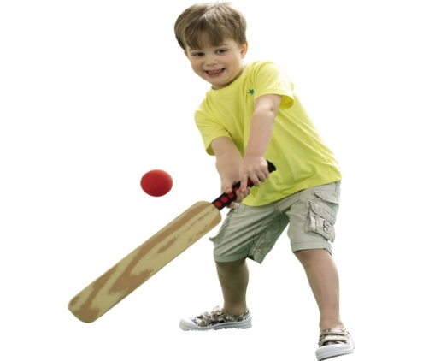
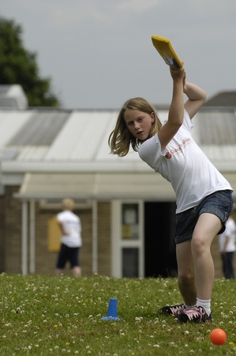
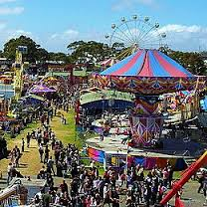
Take your ball and bat out
into your community shopping centres community events
housing estates
parks

Slide 9
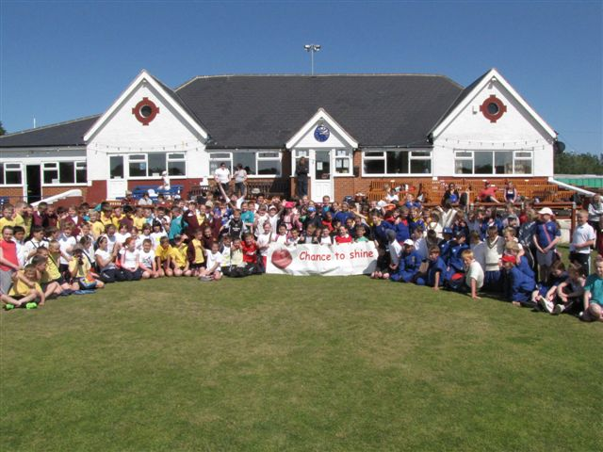
Tynemouth Cricket Club
TYNEMOUTH CRICKET CLUB
A Journey
A JOURNEY

Slide 10
2004
Participation Figures 96
Adult Playing Membership 35
Junior Playing Membership 61
Coaches 19
Matches played 89
Volunteer Roles 94
Subscriptions £5,299
Total Income £43,166

Slide 11
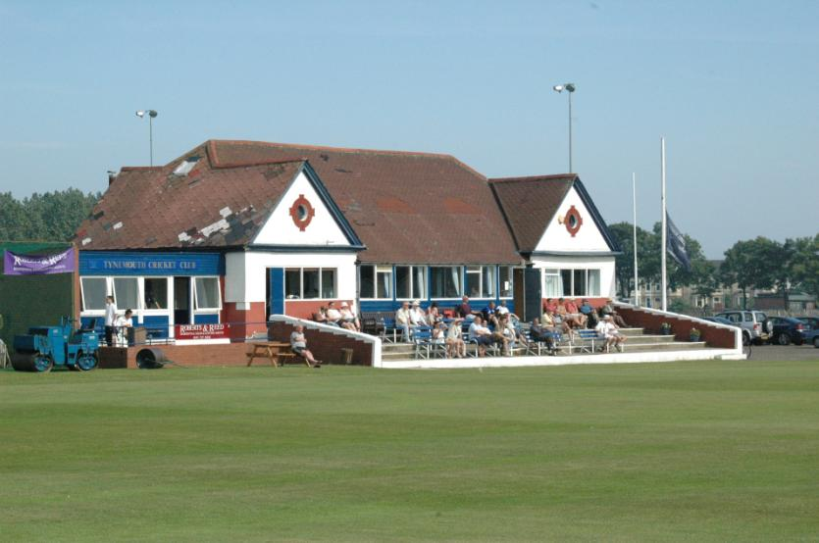
An old and deteriorating clubhouse

Slide 12
NatWest CricketForce
Refurbishment project estimated at £250,000
Massive volunteer fund raising effort – Lands End to John O’Groats bike ride
Winter of volunteer building work
Last minute buy a brick appeal raised nearly £10,000 in two weeks
High profile opening on Cricketforce weekend with press and Durham CCC players in attendance
Members rally to complete pre-season preparations

Slide 13
Chance to Shine – Educating through Cricket Teacher Training provided Free play ground marking or artificial wickets for schools

Slide 14
Other Community Activities
In 2010 Tynemouth CC after five years delivering Chance to Shine became the first sports club to be commissioned by North Tyneside Council to deliver services on its behalf

Slide 15
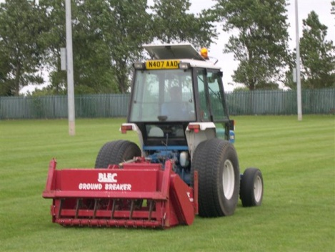
Ground maintenance work
Club groundsman Paul Jackson brings in income from contracts with
Percy Main CC
Kings School
Percy Park RFC
North Shields FC
King Edwards Primary School

Slide 16
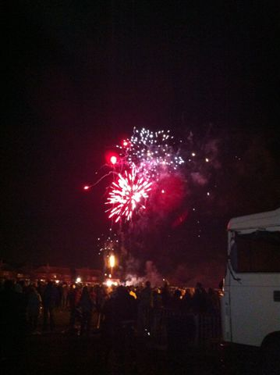
COMMUNITY BONFIRE NIGHT
2015
OVER 5,000 PEOPLE ATTEND – ALL ORGANISED BY VOLUNTEERS

Slide 17
TYNEMOUTH BEER FESTIVAL
FOUR YEARS OLD – 1100 PEOPLE ATTENDED IN 2014

Slide 18
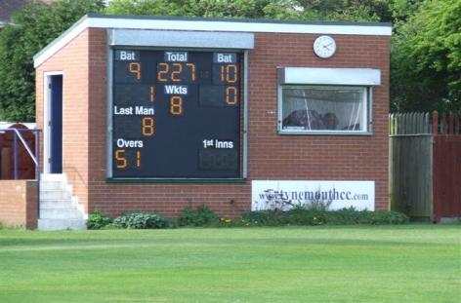
CLUB SUSTAINABILITY
New Groundsman’s Cottage
New wicket covers
Cage net grant for square practice
New drainage costing £6500
New Electronic scoreboard
New ground benches for spectators

Slide 19
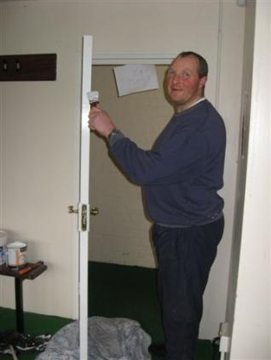
VOLUNTEERS
114 Listed Volunteers
295 Volunteer roles
Two Junior Cricket tours organised by volunteers in 2011
Bonfire night – over 7000 people
Beer Festival – over 1100 people
Junior coaching
Ground and pavilion maintenance
Fund raising
Facility Management
Team management
Links with VODA

Slide 20
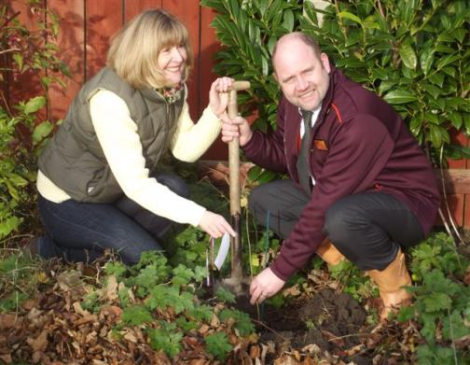
COMMUNITY SUSTAINABILITY
Spirit of cricket theme aimed at improving children’s behaviour rolled out in schools
Sky TV ground equipment trailer costing £20,000 provided so other local clubs can benefit from groundsman’s expertise
Tree planting in conjunction with Woodland Trust
On going search for partners to support our activities

Slide 21
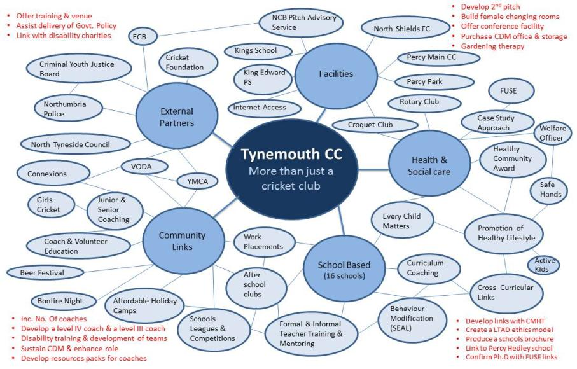
HOW DID WE DO?

Slide 22
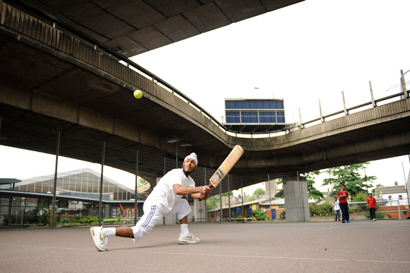
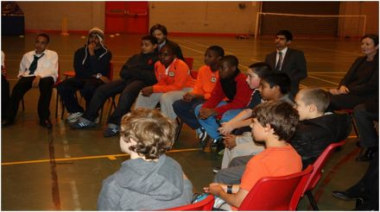
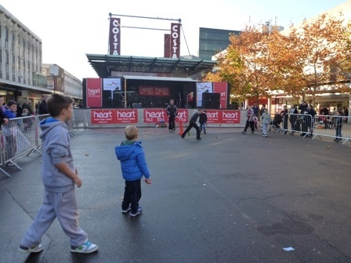

Slide 23
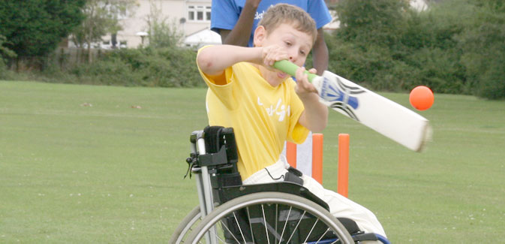

Slide 24
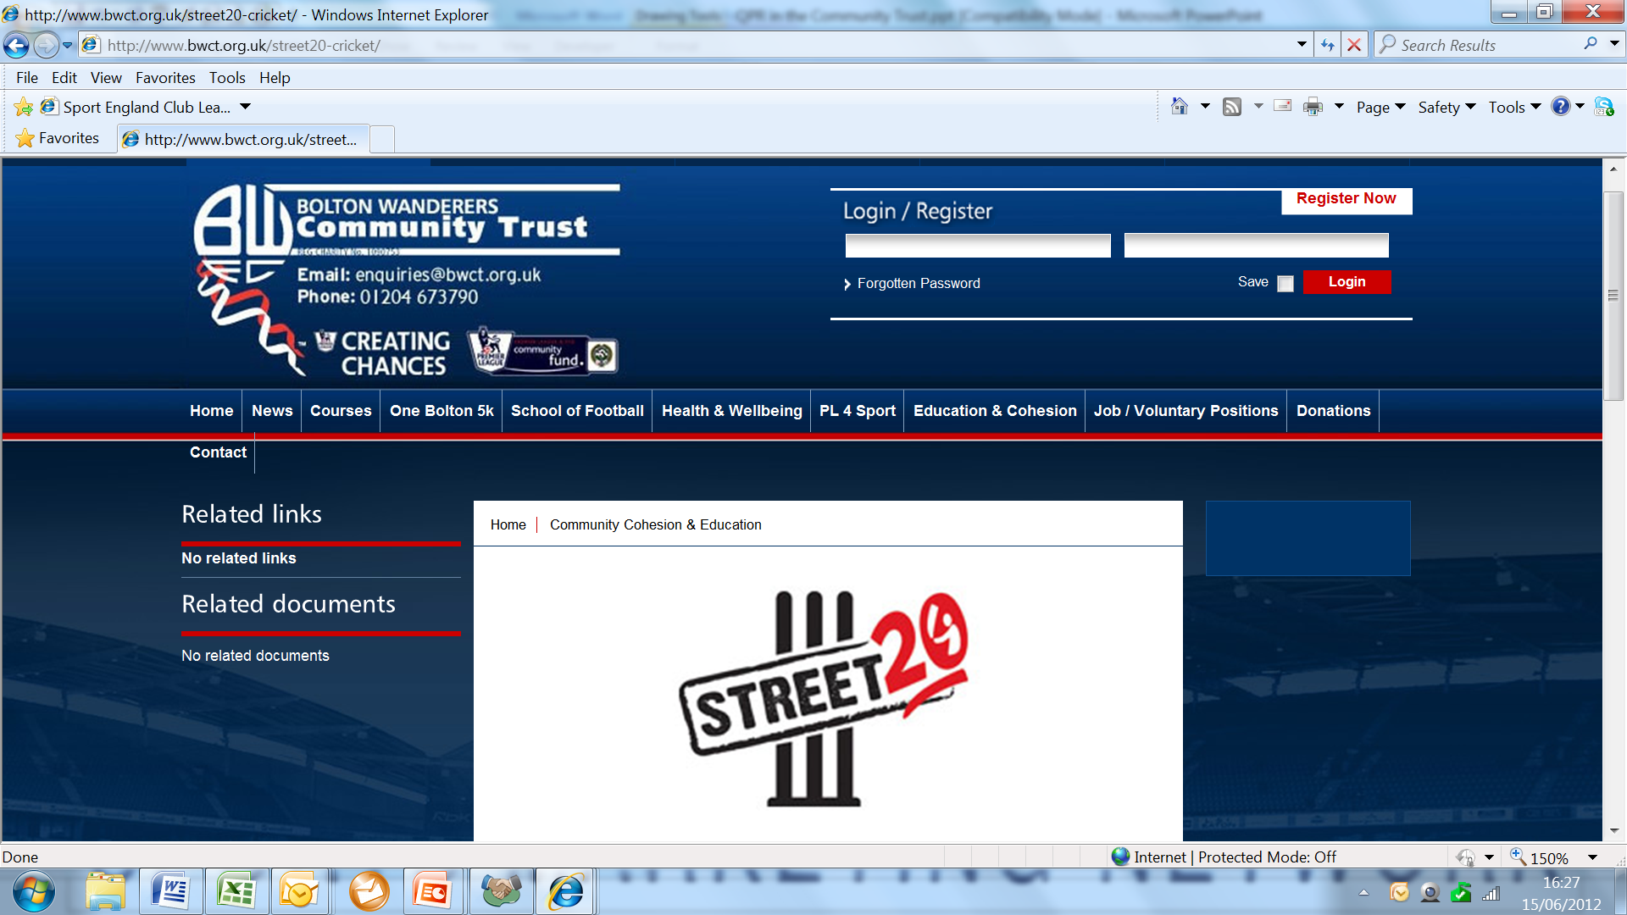
goes to Bolton

Slide 25
employs an Impact Manager do you?

Slide 28
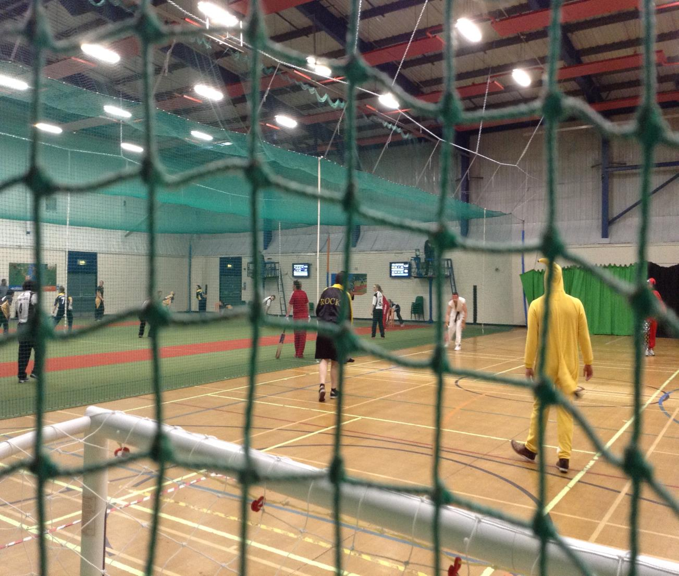

Slide 29
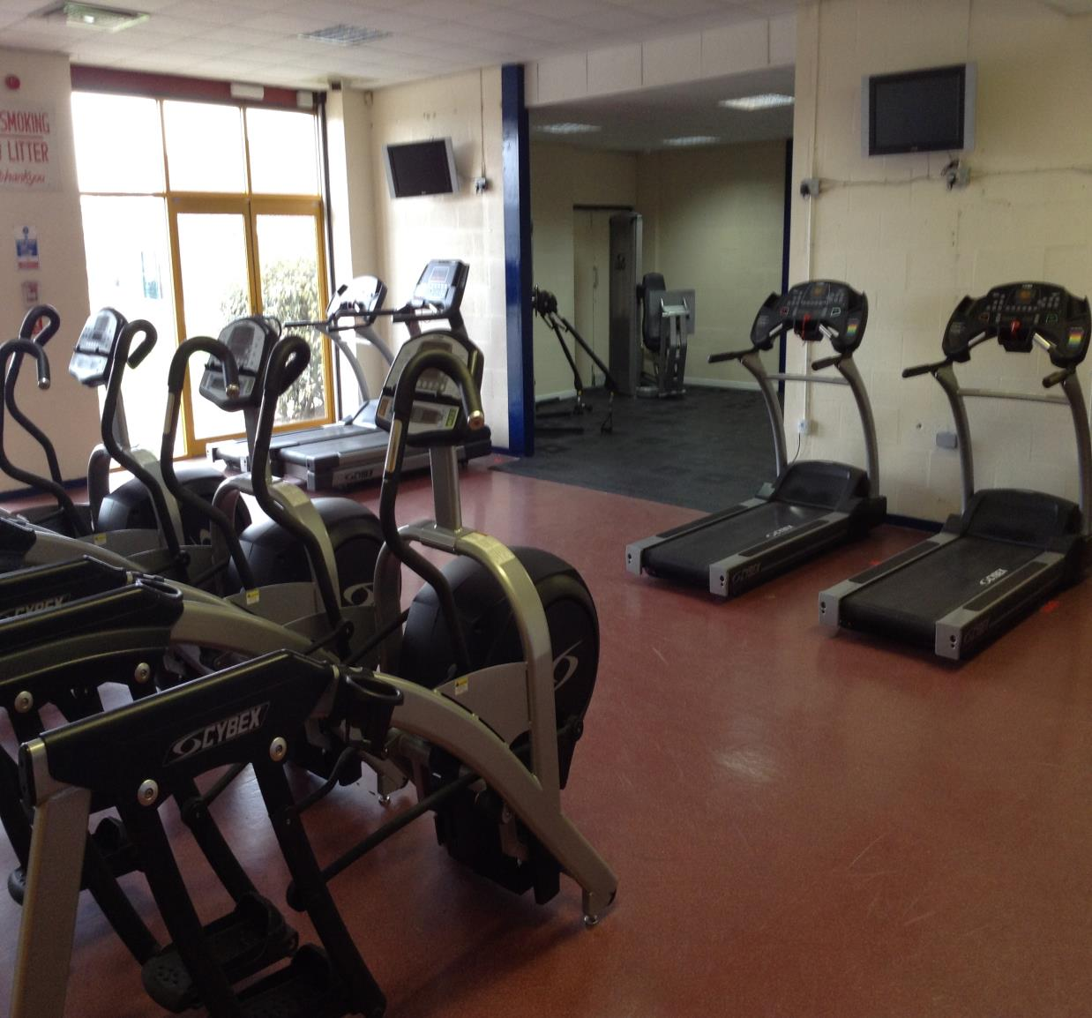

Slide 30
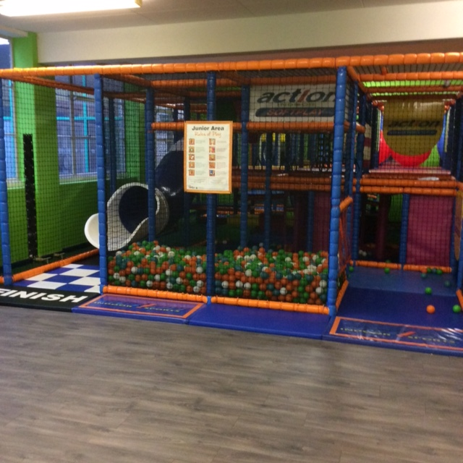

Slide 31
PARTICIPATION
1st 6 Months from Opening
560 Games of Cricket
1,030 Games of Netball
15,000 hours of coaching experiences
12,000 gym sessions / class experiences
300 School participants per week

Slide 32
Factory Skatepark, Dundee
Young people
Skateboarding, Blading, BMX, & Scooters
Soft play business venture
“If kids liked knitting we’d be a knitting centre”

Slide 33
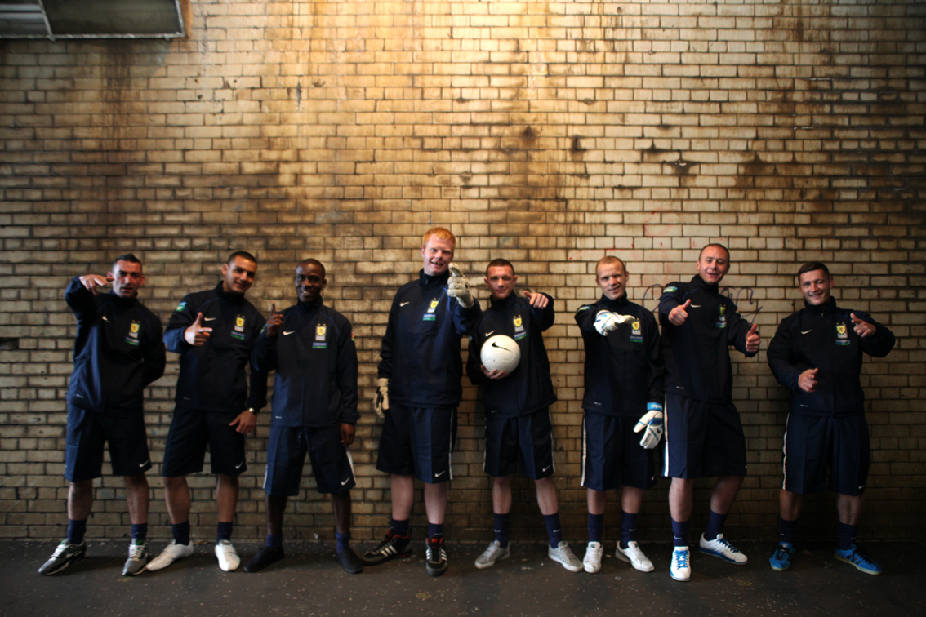
Street Soccer Scotland
Not just local community
Change is the focus
Develop life skills
Work with partners

Slide 34
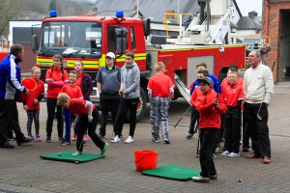
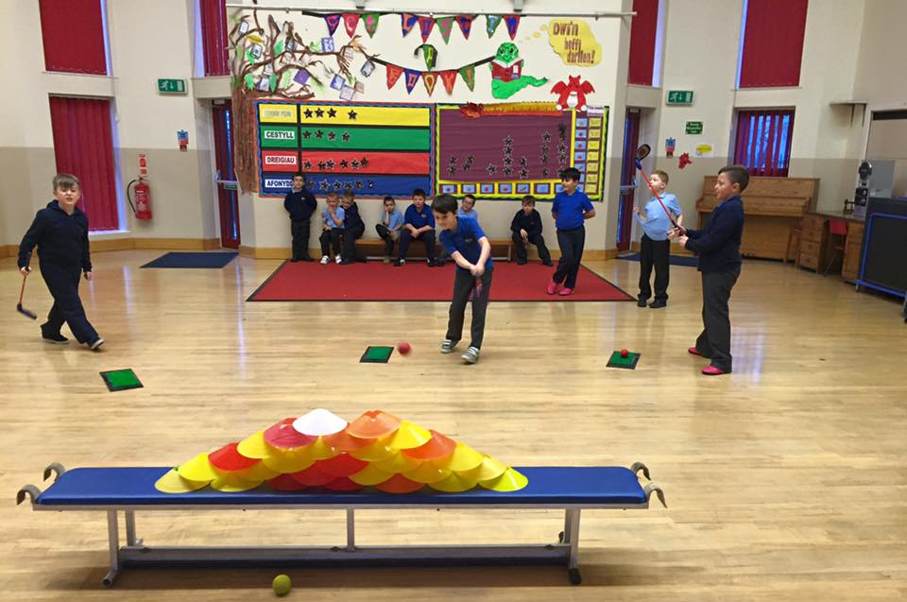
Valleys Golf – Changing lives through golf Introduced 10,000 people to golf in 2015

Slide 35
Common factors
Passionate
Driven to make a difference
Community run
Delivering for local people
Operate like business
Creative

Slide 36
It is also about getting and staying in touch
Identify Connectors both within and outside your sport
People with a special gift for bringing the world together

Slide 37
Create shared value
Work out how to collaborate with others

Slide 38
Income generation can not be an afterthought

Slide 39
Mission and Money – fitting in together?
High
Free sport
for all
Corporate Games
Commissioning
User fees
Mission
Going to
the beach or the pub
Car boot sale
Bag packing
Low
Low
High
Money

Slide 40
From ASK to EARN a balanced income model

Slide 41
Donors
Communicate – how are you spending their money
Make it easy to donate
Tell stories
Raffles/lotteries
Say ‘thank you’

Slide 42
Grants/Funders
Have a BIG idea – what will you achieve
Don’t assume the funder knows about you
Allow enough time
Why are you different
See it from the funder’s/donor’s perspectives
Get ‘a critical friend’ to read/evaluate your bid/application
Avoid ‘mission drift’
Get to know the funder - their needs, their criteria, their language
Demonstrate SUSTAINABILITY

Slide 43
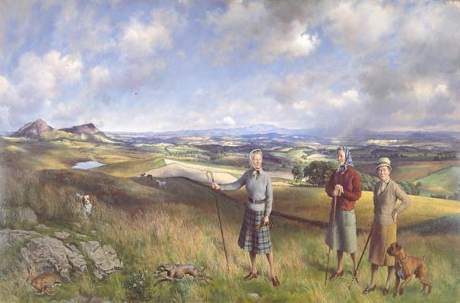
The Robertson Trust

Slide 44
Priorities
7 Priority Areas
What we Fund
Health,
Care,
Education and Training,
Community Art,
Community Sport,
Alcohol Misuse, and
Criminal Justice
Match funder
Flexible funder
Support and encourage learning and development

Slide 45
Community Sport
Sport can be a valuable vehicle to engage hard to reach young people in communities and enable them to develop key life skills

Slide 46
Commissioner
Be part of Civil Society
Partnership delivery
Build relationships
Focus on outcomes
Your enterprise = Community?

Slide 47
Customer: consumer/corporate
Great sporting and consumer experiences
Train coaches in communication and customer services
We are all different = different experiences
More than just £ - Skills, contacts

Slide 48
Users/Members… a key source of income
Adapt user and membership categories to people’s lives – not just what suits you:
Pay ‘n Play/Come ‘n Go
Not just sport (a place where people live their lives)
Bring Granny/Grandad
PEOPLE WILL PAY FOR GREAT EXPERIENCES - JUST ASK

Slide 49
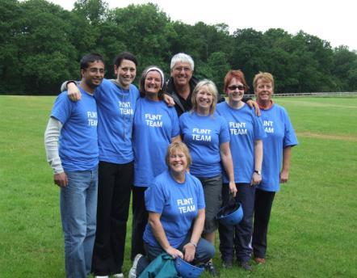
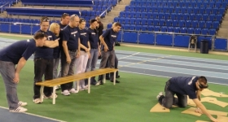
Corporate Sports Events

Slide 50
Social pricing – fair for everyone
£ = concessions
££ = community
£££ = corporate

Slide 51
Proving the Impact of Community Sport
Proving the impact of sport can be challenging for a number of reasons:
Attribution: Difficult to show that engaging in sport causes wider social outcomes to be achieved
External factors: There may be a wide range of reasons why someone benefits or doesn’t benefit from engaging with a sports programme
M&E Skills & Systems: Organisations may lack the knowledge, skills & systems to monitor and evaluate their work.
However, that doesn’t mean we shouldn’t try!

Slide 52
Creating
#MoreThanCricket
more than places where people play cricket
cricket embraces new communities, new players, new partners and additional funding

Slide 53
From Forth Valley Community Cricket Enterprise to:
GoForth
A social enterprise which brings cricket to new communities and help develop cricket for social good

Slide 54
Mission
Taking on bigger, regional community cricket projects that are beyond the scope for clubs
Working with the enterprising clubs
Delivering innovative cricket and community projects taking the sport beyond its current reach
Developing #MoreThanCricket

Slide 55
GoForth – where does it sit?
Somewhere between a ‘strategic’ governing body and volunteer-run cricket clubs

Slide 56
The next steps for GoForth
Decide on activities
Decide on income model
Which legal structure
Start-up funding
Recruit Entrepreneur-in-Chief
Relationship with CS and Forth Valley Clubs

Slide 57
And finally…
Be unique
Demonstrate your values/target groups
Align to sponsors’ target audience
Have a BIG idea – what will you achieve
Tell stories
Engage, engage, engage
Prove outcomes and your impact

Slide 58
Thanks for listening…
Svend Elkjær
Sports Marketing Network
5 Station Terrace
Boroughbridge
YO51 9BU England
Tel: 0044-1423 326 660
Email: svend@smnuk.com
@sportsmarketer #growsport

