Slide 1
CoolCricket Getting more young people into cricket
29th May 2016
Ben Fox
Cricket Scotland
Svend Elkjaer
Sports Marketing Network

Slide 2
Why CoolCricket?
Cricket Scotland would like to have
more young people playing cricket
How do we improve the way we
welcome, treat, coach and communicate
with young people?
We need your help and input, please

Slide 3
The 4 challenges 2 internal 2 external
How to deal?
Other sports
Other interests
inc. education
Perception of cricket and your club
Your club environemnt

Slide 4
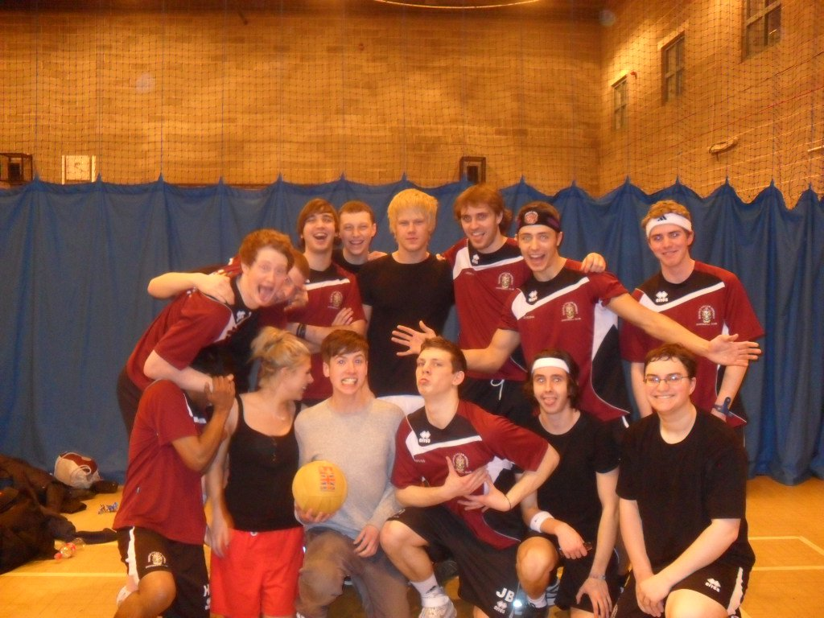
We all want to belong

Slide 5
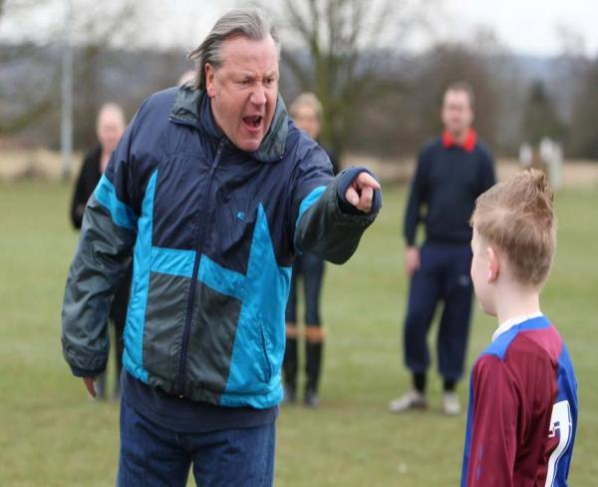
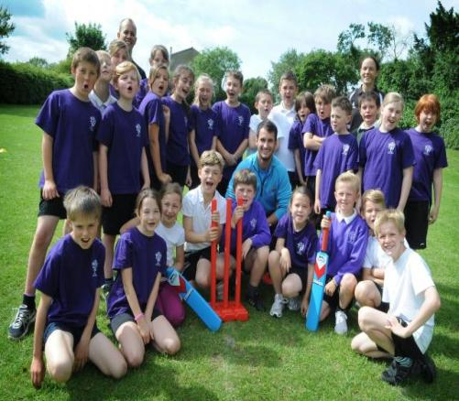
How is your club currently engaging with young people? How would you like to do it?

Slide 6
How should we welcome young people?

Slide 7
How should we treat young people?
Most people will forget what you tell them, but they will never forget how you make them feel

Slide 8
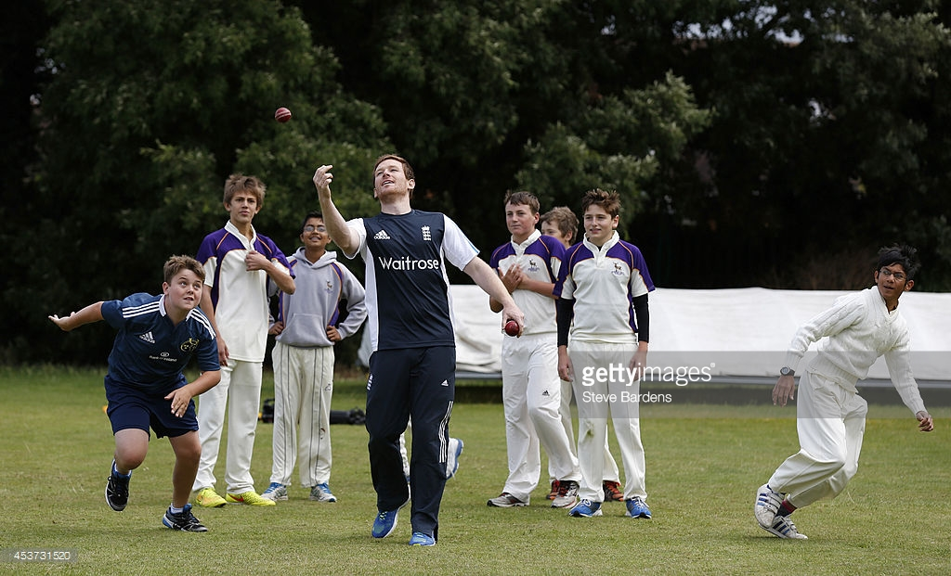
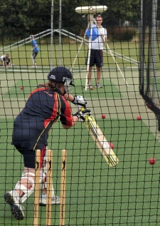
How should we coach young people?

Slide 9
How should we communicate with young people?

Slide 10
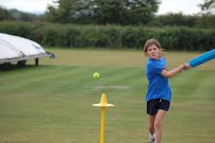
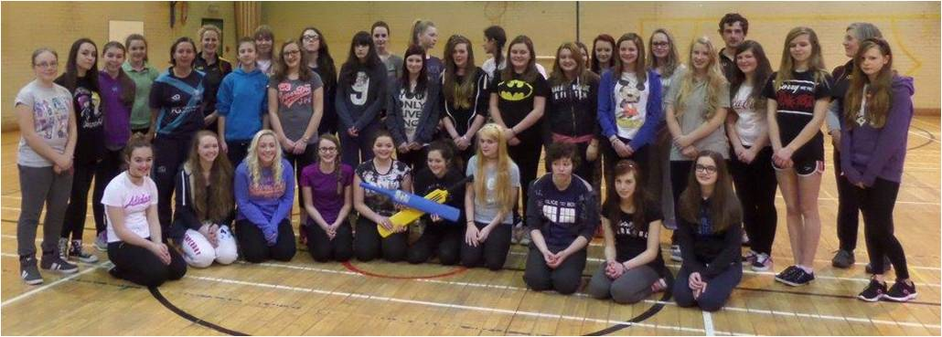
#ShePlaysCricket
Getting more girls into cricket
Music, fun and cake…
Boys and girls together? Or separate?

Slide 11
The WHOLE experience
Think of the whole experience of joining your club:
Decision to attend
Seek information
Booking
Before
Transport/Arrival
Experience at your club/Session
Do you make them feel that your club is cool?
The WOW bits
Follow up (social media)
Ask/listen

Slide 12
Welcome to your club?

Slide 13
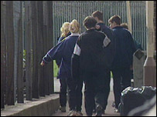
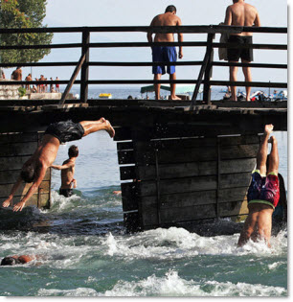
Where do you fit in with young people’s lives?

Slide 14
Where do you fit in with young people’s lives?

Slide 15
Westquarter & Redding CC Introducing “The Westies”
“The friendliest cricket club in The Forth Valley”

Slide 16
Let people dip a TOE
Try
Observe
Experience

Slide 17
Provide great experiences
Why are they leaving?
Boring and repetitive coaching
Waiting around
The same sort of activities in each session
Didn’t like the coach
No longer enjoyed it
No one listened to me
Not enough focus on the social aspects
£ = No 7
81% of young people who left gymnastics said the clubs didn’t care

Slide 18
Could this sign be hanging outside your club?

Slide 19
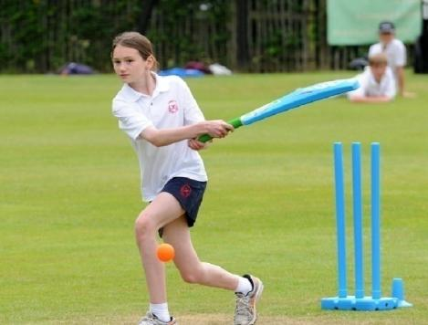
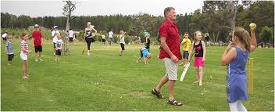
Events: Cricket and...
Food & Drink
Girls
Music Family

Slide 20
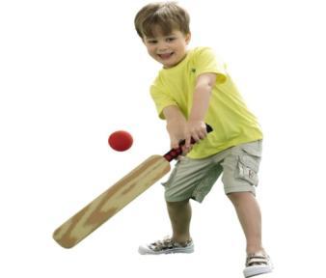
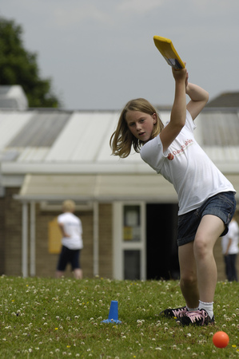
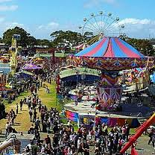
Take your ball and bat out
into your community shopping centres community events
housing estates
parks

Slide 21
A really welcoming Open Day
Think it through – why are you doing it?
People, people, people
Who is it for?
Make sure a great time is had by all
Share value with the community
Members ‘spread the word’ – offline/online
Welcome everybody
More than ‘just cricket’
Joint promotions with local media
A friendly point of contact
Social media share the experience
Follow up, follow up

Slide 22
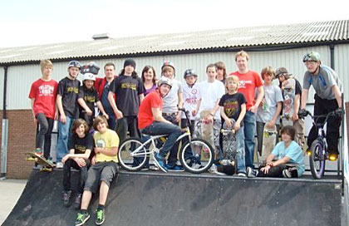
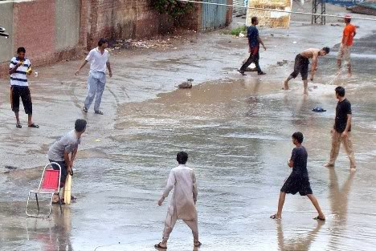
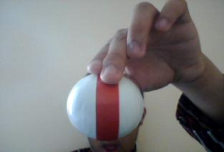
A great social, fun experience
Tapeball Involve them
Play
Don’t be boring!

Slide 23
From School to Club – 10 easy steps (1)
10 easy to follow steps to ease the transition from trying
cricket at school to becoming a club cricketer:
Get to know/work with your Active Schools Coordinators
Involve your YCAs throughout
Understand the requirements of the school and its Head
If possible, get a teacher volunteering with your club, to be
involved
Look at the young people ‘in the round’ (not just as cricketers)
Involve the whole school
Involve the whole family
Make sure there are familiar faces at all stages
Get contact details of parents, etc.
Follow up
Use social media to ‘spread the good word’

Slide 24
Young Cricket Ambassadors (YCA)
Go to your local schools and youth
groups to champion your club and cricket
Increase awareness and interest in cricket in schools, youth clubs and/or communities
Promote the positive values of cricket
Be a role model in advocating cricket
Be the young people’s voice in schools, clubs, and communities

Slide 25
Poassible activities for YCAs
Leading or assisting coaching sessions
Accountable for registration, taking payments and administrative roles
Setting up extra-curricular activities in schools, thus bridging the gap between schools and club
Introducing and regularly delivering hockey into local primary schools
Organising local fun days, festivals and mini tournaments
Developing a Club Awards Ceremony

Slide 26
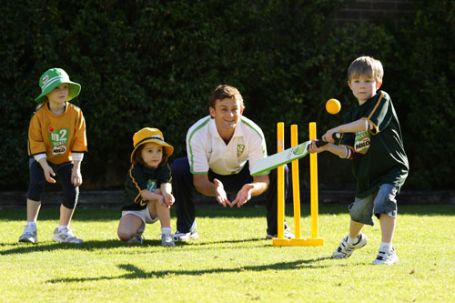
RoBo – Research Online Buy Offline

Slide 27
“People fear what they don't understand and hate what they can't conquer.”= ― Andrew Smith

Slide 28
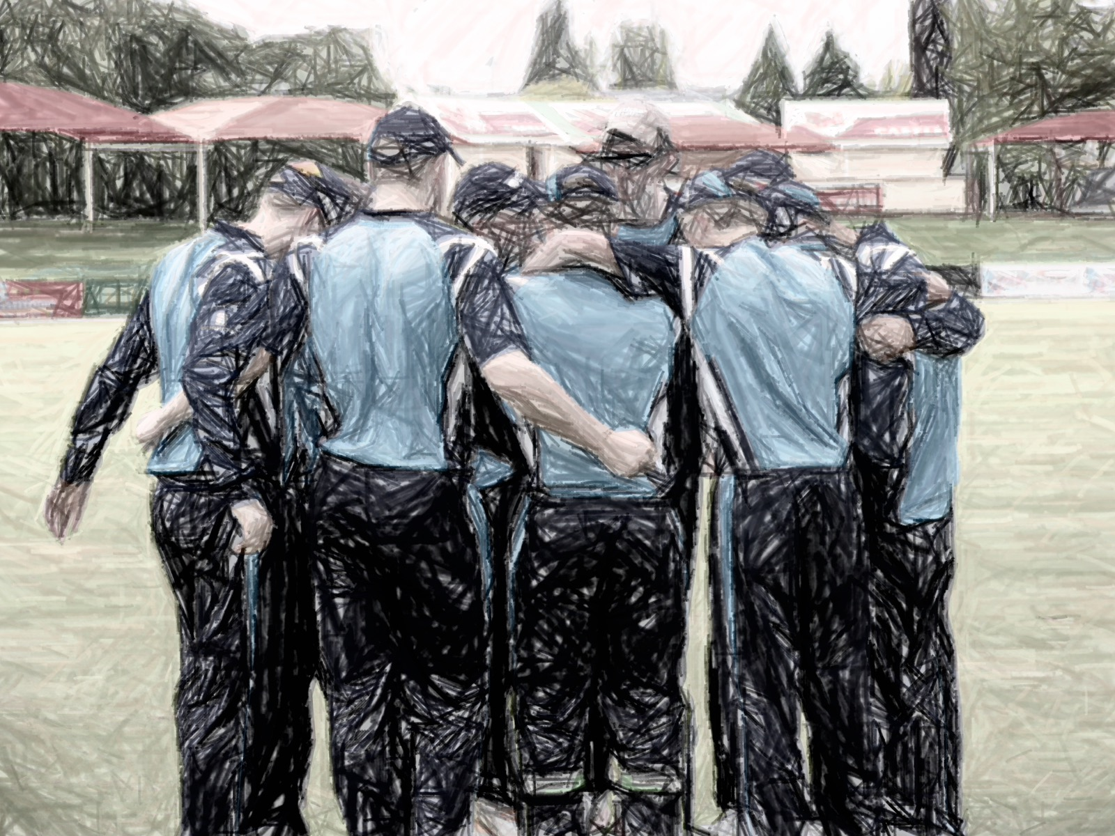
Group Exercise
Split into groups of 5
Task 1 – The different platforms you use and what sort of content?
Task 2 - What sort of discussions has been had about social media at your club? Who would you look to approach on the subject?

Slide 29
How are you using social media at your club?
Do you have a tone? Formal/Informal/friendly/fun? What are your messages?
Try not to speak in the first person
What are your aims? Who decides
Always try to set targets, no matter how small – have a plan.

Slide 30
Getting the basics right
Fixtures/encouraging spectators to come down, providing final scores/updates. What’s going on at your club?
Timings of posts (hugely important) when will your players/supports see it. Importance of reposting.
Social Media builds credibility
Tell the WHOLE story!

Slide 31
Not a one man and his dog sort of job!
Build a community – different teams, including women's, disability sections & close school links Create close links with website editor, photographer, captains
Communication – set up a sharing network with key content creators in your club.

Slide 32
The iphone Age
Great tool for creating content
Videos – slow mo's, panorama shots, equipment, vines, blogs
Instagram
GoPro

Slide 33
The power of video
Go Pro Footage
Changing room ideas/challenges
Running Man
Why not set up a YouTube account?

Slide 34
Hootesuite – good for monitoring
Bitly – how many clicks is your content achieving?
Facebook Analytics - mix up the variety of posts.
Fotor
Twitter Video
YouTube channel – embed into the website
Google Analytics
Dropbox – Good for sharing

Slide 35
Making it happen The three 3s
3 Things You will Stop Doing
3 Things You Will do Better
How Will You Know Your are Doing Them Better?
3 Things You Will Start Doing

Slide 36
What would you like from us?
How can Cricket Scotland help you?
What would be useful?

Slide 37
Let’s stay in touch…
Ben Fox
Cricket Scotland
National Cricket
Academy
Ravelston
Edinburgh
EH4 3NT
0131 313 7421
benfox@cricketscotland.com
@NorthernFox84
Svend Elkjaer
Sports Marketing
Network
5 Station Terrace
Boroughbridge
YO51 9BU
01423 326660
svend@smnuk.com
@sportsmarketer

